Slide 1
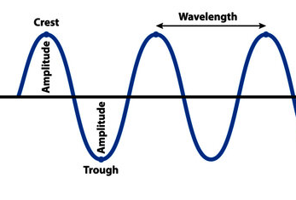
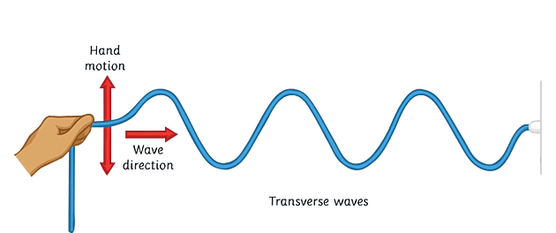
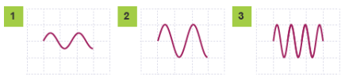

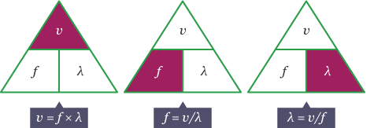
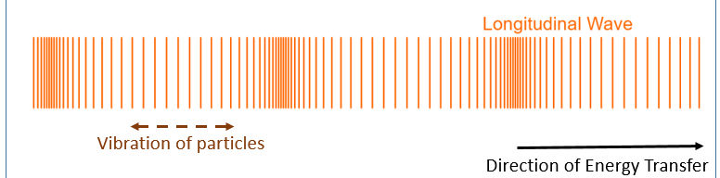


Knowledge Organiser
Year 8: Waves – Wave Properties
Diagram showing the labelled features of a transverse wave
How do we change the pitch of a sound?
Pitch is how high or low a sound is
It is determined by the frequency of the wave
High frequencies are high pitched
What is a wave?
A wave is a disturbance which transfers energy
Waves may vibrate matter but they do not move it from its original location
Waves come in two types; transverse and longitudinal
How do we change the volume of a sound?
Volume is a measure of loudness
It is determined by the amplitude of the wave
A high amplitude will sound loud
Diagram showing the wave form of;
1. quiet, low pitch sound, 2. loud, low pitch sound and 3. loud, high pitch sound
Diagram which shows the action of a transverse wave on a rope
What are the features of a wave?
Amplitude is the distance from the mid-point to the peak/trough
It is the maximum disturbance of a particle caused by the vibration
Wavelength is the distance taken for a complete wave
Wavelength is usually measured from peak to peak or trough to trough
Wave speed equation:
Wave speed = Frequency x Wavelength
Transverse waves?
In a transverse wave the vibrations are perpendicular (at right angles) to the direction of wave travel
Examples of transverse waves include: ripples on the surface of water, electromagnetic waves
Diagrams showing how to rearrange the wave speed equation to calculate frequency and wavelength
What about frequency?
Frequency is the number of complete waves which are produced each second
The unit of frequency is hertz (Hz)
The time period of a wave is the time taken for one complete wavelength
It is calculated as 1/frequency
Diagram which shows the action of a longitudinal wave
 | Definition | Symbol | Units
Wavelength | Distance from peak to peak | λ | Meters (m)
Frequency | Number of waves per second | f | Hertz (Hz)
Time period | Time taken for a complete wave | T | Seconds (s)
Wave speed | Speed a wave travels at | v | Meters per second (m/s)
RAG Yourself!
Learning Outcomes; | RAG
Describe the difference between transverse and longitudinal waves
Define parallel and perpendicular
Label a diagram with wavelength and amplitude
Define frequency and time period of a wave
Describe how to change the pitch and volume of a sound in terms of wave shape
Rearrange the wave speed equation to calculate frequency and wavelength
Longitudinal waves?
In a longitudinal wave the vibrations are parallel to the direction of the wave travel
Examples of longitudinal waves include: sound waves, seismic waves

Slide 2
Knowledge Organiser
Year 8: Waves – Wave Properties
Diagram showing the labelled features of a transverse wave
How do we change the pitch of a sound?
What is a wave?
How do we change the volume of a sound?
Diagram showing the wave form of;
1. quiet, low pitch sound, 2. loud, low pitch sound and 3. loud, high pitch sound
Diagram which shows the action of a transverse wave on a rope
What are the features of a wave?
Wave speed equation:
Transverse waves?
Diagrams showing how to rearrange the wave speed equation to calculate frequency and wavelength
What about frequency?
Diagram which shows the action of a longitudinal wave
 | Definition | Symbol | Units
Wavelength
Frequency
Time period
Wave speed
RAG Yourself!
Learning Outcomes; | RAG
Describe the difference between transverse and longitudinal waves
Define parallel and perpendicular
Label a diagram with wavelength and amplitude
Define frequency and time period of a wave
Describe how to change the pitch and volume of a sound in terms of wave shape
Rearrange the wave speed equation to calculate frequency and wavelength
Longitudinal waves?

